Slide 1
Integrative Modeling of Coal-Induced CO2 Emissions Using a Hybrid ARIMA–NNAR Architecture: A Nonlinear Time Series Forecasting Approach for Environmental Systems
Ushosree Raha
Adamas University
B.Sc.(Hons.) Statistics and Data Analytics
Department of Mathematics
AU/2022/0008058
UG/05/BSTDA/2022/005
Guided by-
Mr. Anirban Maity
Adjunct Faculty, Department of Mathematics
Adamas University

Slide 2
CO₂ Emissions
CO₂ Emissions from Coal
ARIMA Model Analysis
Model Selection and Diagnostic
Model Performance
NNAR Model Analysis
Model Selection and Diagnostic
Model Performance
Contents
Hybrid ARIMA-NNAR Model Analysis
Model Selection and Diagnostic
Model Performance
ARIMA Model Forecasting
NNAR Model Forecasting
Hybrid ARIMA-NNAR Model Forecasting
Forecasting Analysis

Slide 3
Introduction
🛢️🔥 CO₂ Emissions from Coal
This study looks at how much carbon dioxide (CO₂) the U.S. releases from using coal.
📊📉 Three Methods to Study the Data
ARIMA (a statistical model to find patterns over time)
NNAR (a neural network that improves predictions)
Hybrid ARIMA-NNAR Model
🔮🌍 Why It Matters
To predict future emissions and understand how they might affect the environment.

Slide 4
Study Objectives
🔍 Look at Past CO₂ Emissions
We study how much CO₂ came from oil coal in the past.
📈 Find Patterns or Cycles
We check if emissions follow any trends or seasonal patterns (like going up or down over time)
🔮 Predict Future Emissions with ARIMA
We use a time series model called ARIMA to forecast what emissions might look like in the future.
🤖 Compare Models (ARIMA vs NNAR)
We also use a neural network (NNAR),hybrid NNAR-ARIMA model and compare it with ARIMA to see which works better.

Slide 5
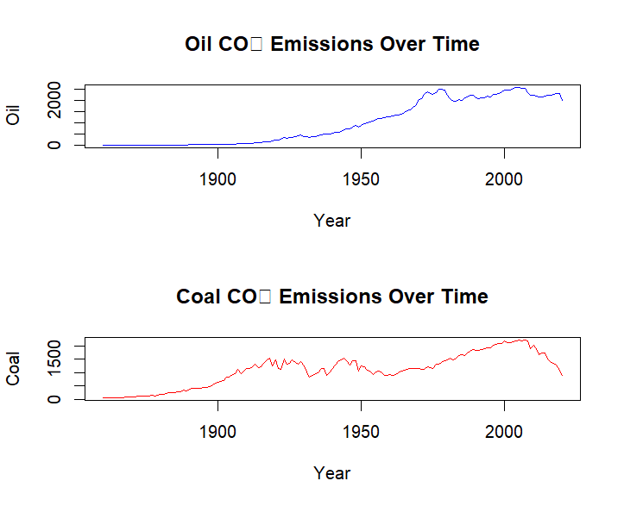
CO₂ Emissions from Coal
Emissions were very low in the late 1800s.
From around 1900, emissions started to grow steadily.
Between 1920 and 1950, emissions had some ups and downs but stayed mostly high.
After 1950, emissions slowly increased again until around 2005.Around 2005, emissions began to decrease noticeably.
Coal CO₂ emissions grew steadily in the early 20th century, stayed high with some fluctuations mid-century, and then started to decrease after 2005.

Slide 6
Choosing Best ARIMA Model
Model | RMSE | MAE | MAPE | ACF1 | Ljung–Box p-value
ARIMA(3,1,1) | 95.41 | 64.34 | 6.79 | -0.0054 | 0.1906
ARIMA(3,1,2) | 94.44 | 62.86 | 6.63 | 0.0044 | 0.2818
ARIMA(3,1,3) | 94.40 | 62.77 | 6.63 | -0.0005 | 0.1736
ARIMA(3,1,11) | 88.92 | 61.66 | 6.53 | -0.0032 | 0.1801
ARIMA(3,1,12) | 88.88 | 61.67 | 6.53 | -0.0024 | 0.1768
ARIMA(7,1,1) | 93.19 | 62.73 | 6.65 | -0.0072 | 0.0379
ARIMA(7,1,2) | 91.73 | 63.23 | 6.72 | -0.0001 | 0.0429
ARIMA(7,1,3) | 91.72 | 63.16 | 6.69 | 0.0006 | 0.0124
ARIMA(3,1,2) best model – lower RMSE/MAE/MAPE and p>0.05

Slide 7
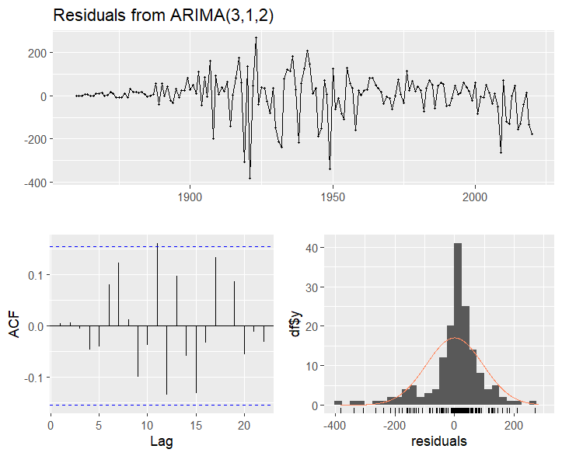
Checking the ARIMA(3,1,2) Model for Coal Emissions
Top Plot – Residuals Over Time : Most values stay near zero, which is what we want. However, in the early 1900s, there are large swings, showing some instability that model may not fully capture.
Bottom Left – ACF Plot: Most bars are inside the blue lines, which means the model has removed most patterns. A few bars suggest small leftover time patterns.
Bottom Right – Histogram of Residuals: The shape is close to a bell curve, with many values near zero and a few extreme ones. It’s not perfectly normal, but still looks reasonably good.
Ljung-Box Test:
The p-value is 0.2818, which means there’s no strong evidence of leftover patterns , white noise
— the model fits the data fairly well.

Slide 8
Residual Statistics Summary for ARIMA Models
Statistic | Ideal | Coal | Interpretation
Mean | Close to 0 | 0.49 | close to 0 → minimal bias
Variance | Lower is better | 8974.21 | More Volatile
Skewness | Near 0 | -1.15 | Slight left skew → more small values
Kurtosis | 3 | 6.02 | Heavy tails → presence of outliers
It shows minimal bias, but coal residuals are more spread out and contain more extreme values.

Slide 9
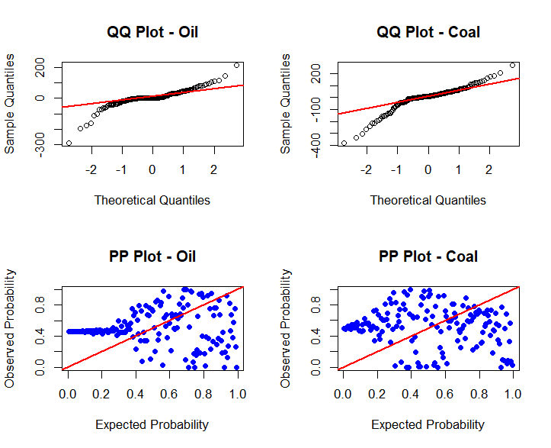
📉 Normality Check of Residuals (Q-Q & P-P Plots)
🟩 Q-Q Plots (Top)
Coal: Follows the line better than oil → closer to normal, but still mild deviations.
🟦 P-P Plots (Bottom)
Coal: Some scatter, but less severe → closer to normal
Residual are not perfectly normal. But they are closer to a normal distribution. This suggests the coal model may be reliable for predictions, though it might benefit from further improvement.

Slide 10
Shapiro-Wilk Normality Test
Model | W Statistic | p-value | Conclusion
Coal | 0.897 | < 0.0001 | Not normally distributed
The Shapiro-Wilk test checks if residuals follow a normal distribution.
Coal models fail the test → residuals not normal
Suggest ARIMA may miss some patterns, especially nonlinear or extreme values

Slide 11
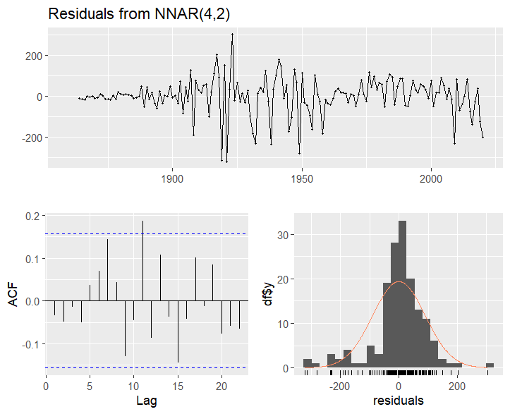
Checking the NNAR(4,2) Model for Coal Emissions
Plot | Insight
Time Plot | Residual spread changes over time → possible heteroskedasticity
ACF Plot | Some mild autocorrelation → a few patterns may be left in the data
Histogram | Residuals centered around 0 ,but slightly skewed
Ljung-Box Test Result
p-value = 0.5452 → Residuals act like white noise
Suggests the model captured most key patterns
Here, Minor issues with skewness and autocorrelation remain , but overall, the model performs reasonably and is useful for forecasting.

Slide 12
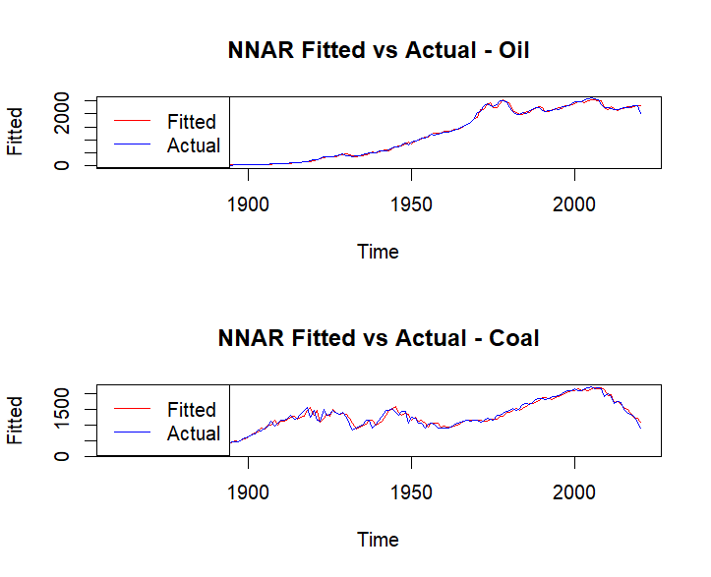
NNAR Model – Fitted vs Actual ( Coal CO₂ Emissions)
🔹 Lines are mostly close, with small differences in a few places
🔹 Still does a good job capturing the rise and fall in coal emissions
The NNAR model shows high predictive accuracy
→ It effectively matches the real emission patterns for coal.

Slide 13
Hybrid ARIMA–NNAR Model
Step 1: ARIMA for Linear Patterns
ARIMA removes obvious trends and gradual shifts in the CO₂ data.
It handles the “straight‑line” behavior well.
Step 2: NNAR for Nonlinear Patterns
We take ARIMA’s leftover errors (residuals) and train a small neural network (1 lag, 1 hidden neuron).
This NNAR catches any bumps, jumps, or curves that ARIMA misses.
This Helps:
  Combines strengths: ARIMA for line, NNAR for curve.
  Better accuracy: Captures both predictable trends and unexpected changes.
  Keeps model simple: Only one hidden neuron avoids overfitting.

Slide 14
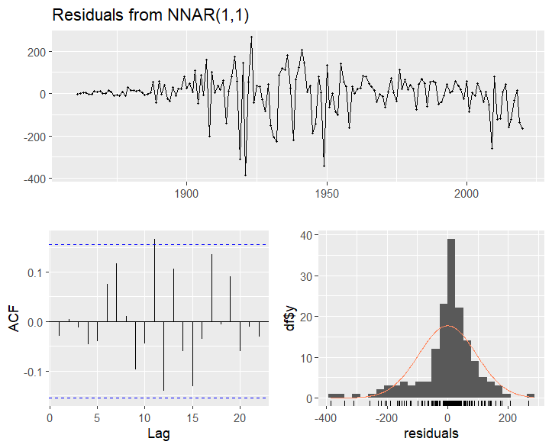
Residual Diagnostics of NNAR(1,1) Model for Coal Emissions
Plot | Interpretation
Top Plot: Residuals Over Time | Residuals are mostly centered around zero but show large fluctuations, suggesting possible model underfitting in early data.
Bottom Left: ACF Plot | Most bars fall within the confidence bounds → little to no autocorrelation, though a few spikes hint at some remaining structure.
Bottom Right: Histogram | General bell shape, but with asymmetry and outliers → residuals are not perfectly normally distributed.
p-value = 0.8189 — The model fits the coal emissions data fairly well, with no major unexplained patterns.

Slide 15
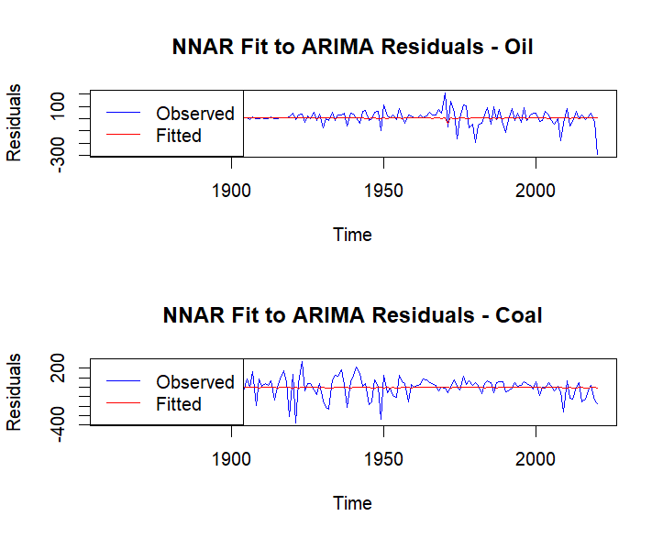
NNAR Fit to ARIMA Residuals – Oil vs. Coal
Model | Interpretation
Coal | The NNAR fit captures the general pattern of ARIMA residuals but struggles more during earlier years (pre-1950), where large fluctuations occur. The model fits better in more stable periods.

Slide 16
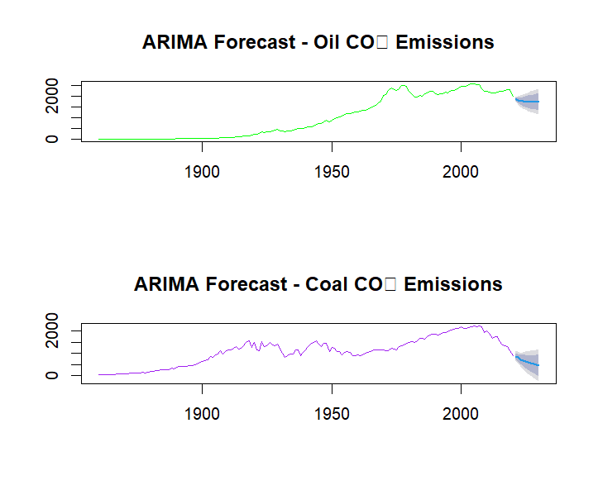
ARIMA Model Forecasting
Forecast | Interpretation
Coal CO₂ | The forecast also suggests a continued decrease in emissions. Emissions peaked around 2005 and have been falling since. The shaded area shows the forecast uncertainty.
The ARIMA model shows that coal-related CO₂ emissions are steadily going down, likely due to cleaner energy use and better policies. While the model gives a good forecast, there’s still some uncertainty, especially for the long term. It may also miss sudden or unusual changes in the data.

Slide 17
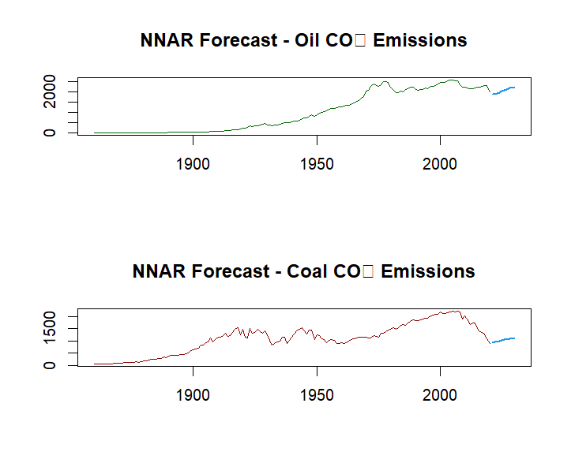
NNAR Model Forecasting
Forecast | Interpretation
Coal CO₂ | Forecast indicates a continuation of the recent decline in coal emissions. The model captures the recent downward momentum effectively.
The NNAR model also shows that coal emissions will likely keep going down, following recent trends. It captures patterns in the data well, especially when they are not purely linear, making it useful for handling more complex or nonlinear changes.

Slide 18
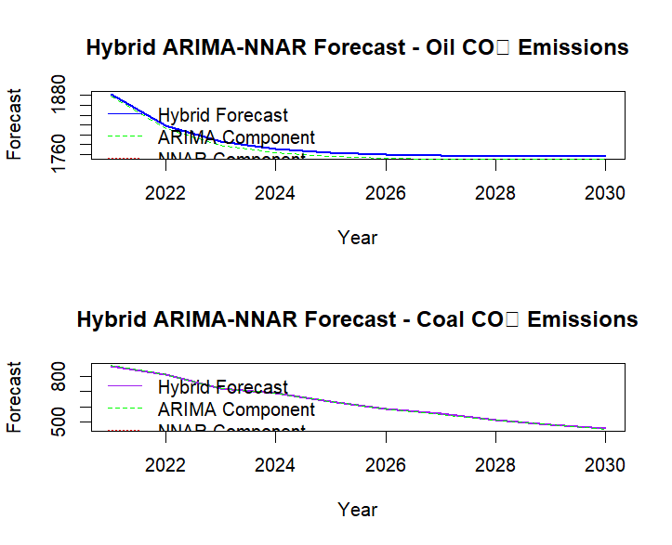
Hybrid ARIMA-NNAR Model Forecasting
Forecast | Interpretation
Coal CO₂ (Bottom Plot) | Forecast shows a steeper downward trend for coal emissions. The NNAR component adjusts for nonlinear decline patterns, enhancing ARIMA’s output.
The hybrid ARIMA–NNAR model forecasts a sharper drop in coal emissions, improving upon ARIMA's linear trend by capturing nonlinear patterns. This combined approach offers a more accurate and flexible prediction of future emission levels.

Slide 19
Simple Ways to Keep USA Environment Clean and Safe
.
Promote Clean Energy: Encourage the use of solar, wind, and other renewable energy sources instead of coal and oil to reduce air pollution and carbon emissions.
Strict Pollution Control Laws: Enforce rules to limit harmful emissions from factories, vehicles, and power plants to keep the air and water clean.
Reforestation and Green Spaces: Plant more trees and protect forests to absorb CO₂, improve air quality, and support wildlife.

Slide 20
Reference
Box, G.E.P., & Jenkins, G.M. (1976). Time Series Analysis: Forecasting and Control. Holden-Day.
Zhang, G.P. (2003). Time series forecasting using a hybrid ARIMA and neural network model. Neurocomputing, 50, 159–175. https://doi.org/10.1016/S0925-2312(01)00702-0
Khashei, M., & Bijari, M. (2011). A novel hybridization of artificial neural networks and ARIMA models. Applied Soft Computing, 11(2), 2664–2675. https://doi.org/10.1016/j.asoc.2010.10.015

Slide 21

Thank You!!

